Slide 1
Linear Regression
Week 2

Slide 2
Recall
How did your tutorial go? Did you complete the post-class activities?
Do you feel more confident about using Python?
What did we do last week?
What was the takeaway?

Slide 3
Meaningful Problems
My problem was a very simple one (I made it a simple one!!)
Usually real-world problems are quite complex
Let us say we want to predict housing prices
What are the things affecting this?

Slide 4
Boston Housing Problem
Boston is a city in the US
Housing data was collected in 1978
506 homes with 13 ‘features’ and one thing to be predicted

Slide 5
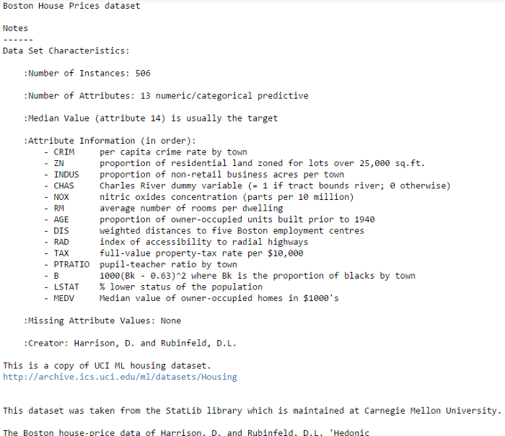
The Data: Characteristics

Slide 6
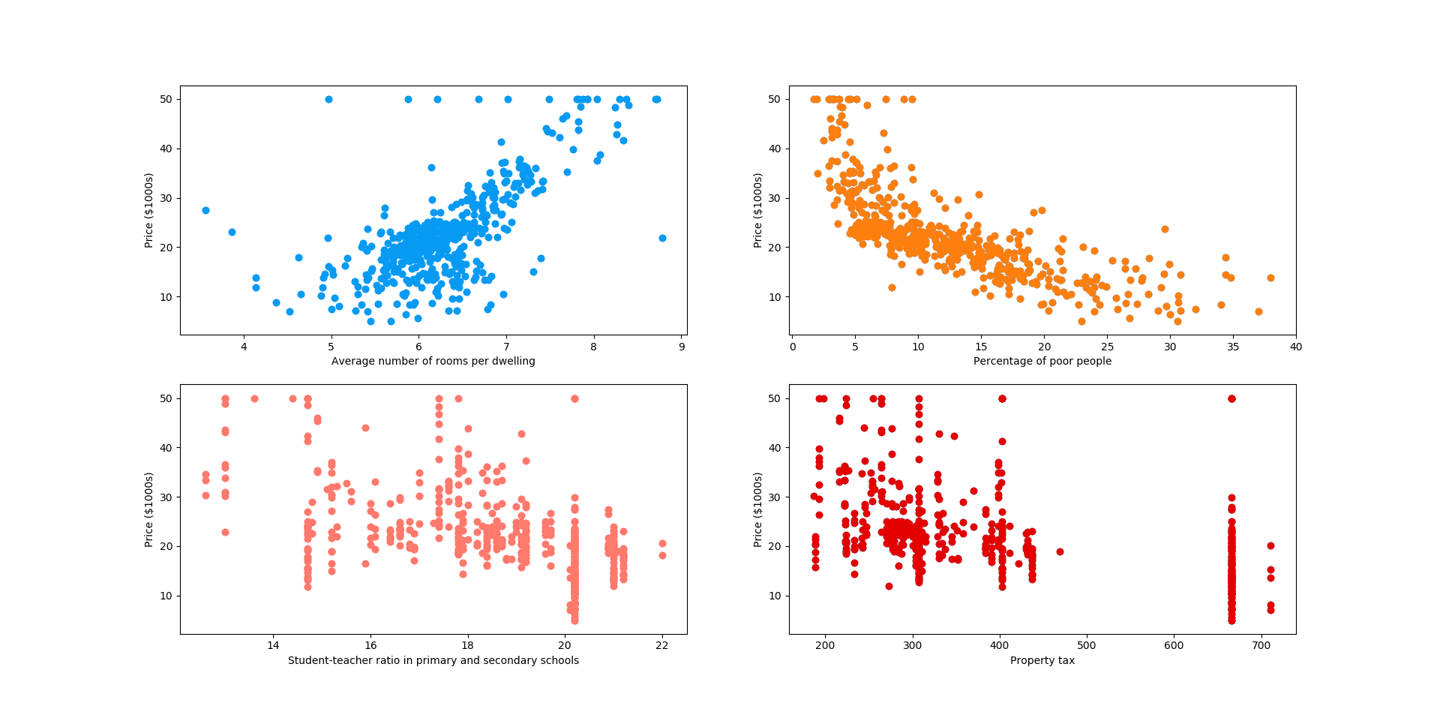
Visualizing Data
Very difficult to do with these many features

Slide 7
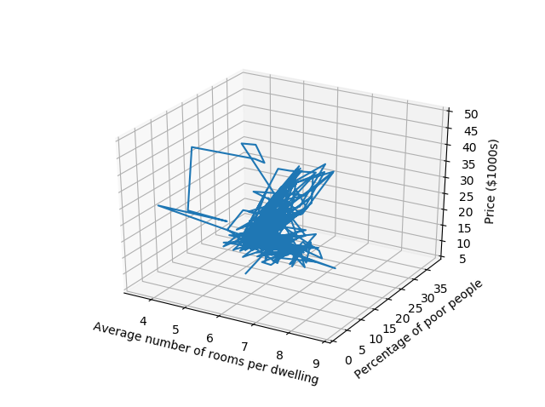
Visualizing Data

Slide 8

Multiple Linear Regression
Recall
$$y=θ_{0}+θ_{1} x$$
Now
$$y=θ_{0}+θ_{1} x_{1}+θ_{2}x_{2}+θ_{3}x_{3}+ …+θ_{p}x_{p}$$
$$y=θ_{0}+\sum_{\left\{i=1\right\}}^{p}{θ_{i}x_{i}}$$

Slide 9
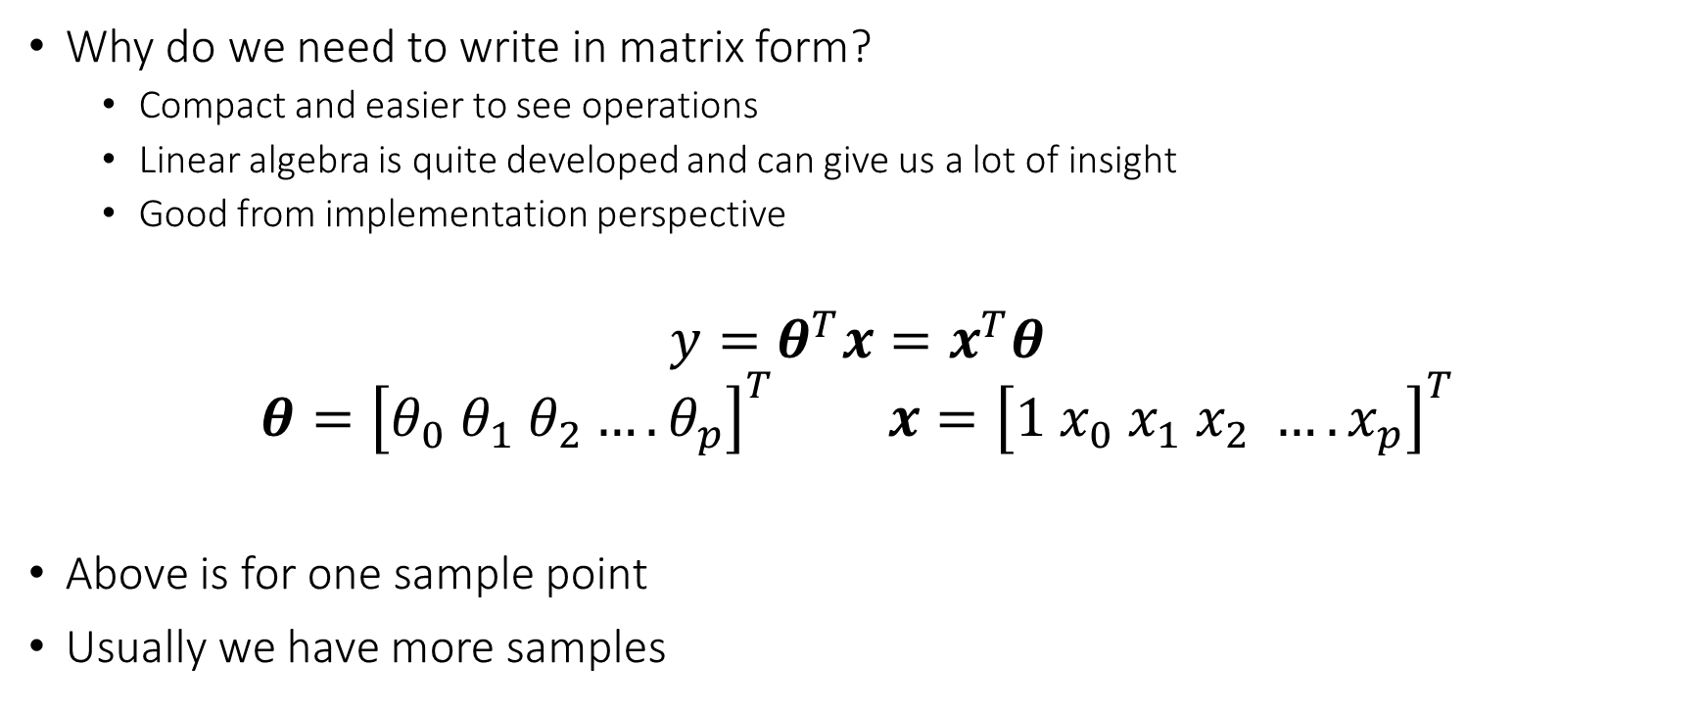
Multiple Linear Regression: Matrix Form
Why do we need to write in matrix form?
Compact and easier to see operations
Linear algebra is quite developed and can give us a lot of insight
Good from implementation perspective
$$y=θ^{T}x=x^{T}θ$$
$$θ={\left[θ_{0} θ_{1} θ_{2}…. θ_{p}\right]}^{T} x={\left[1 x_{0} x_{1} x_{2} …. x_{p}\right]}^{T}$$
Above is for one sample point
Usually we have more samples

Slide 10

Multiple Linear Regression: Solution
$$y=X^{T}θ$$
Again we utilize the ordinary least squares
The solution is
$$θ={\left(X^{T}X\right)}^{−1}X^{T}y$$

Slide 11
Back to the Boston Housing Problem
Features are our x
Form X matrix and y vector

Slide 12
Boston Housing Problem: Solution
features | estimatedCoefficients
CRIM | -0.107170557
ZN | 0.04639522
INDUS | 0.02086024
CHAS | 2.688561399
NOX | -17.79575866
RM | 3.80475246
AGE | 0.000751062
DIS | -1.475758797
RAD | 0.305655038
TAX | -0.012329346
PTRATIO | -0.953463555
B | 0.009392513
LSTAT | -0.525466633

Slide 13
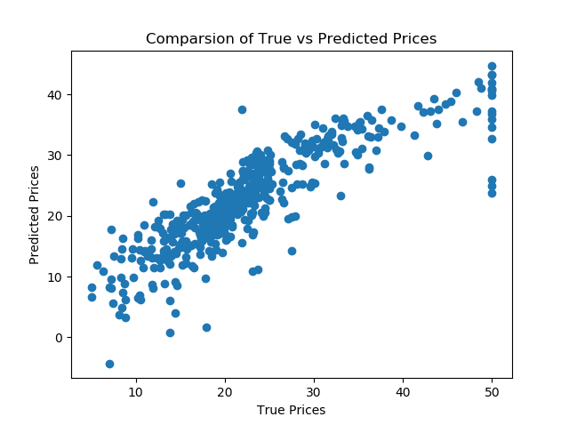
Comparison
Errors are there
Is this the best way to solve this problem?
Can we achieve lower error threshold?

Slide 14

Characterizing Error
What other ways can the error be characterized?
Mean Square Error (MSE)
$$MSE={\frac{1}{N} \sum_{i=1}^{N}{{\left(y_{i} −f\left(x_{i}\right)\right)}^{2}}}$$
For our problem MSE = 21.9

Slide 15
Recap
What did we do today?
What did you learn?
What can you do now that you could not before?
Remember your post-class activities

